Slide 1


Sang Kha
2021-11-07

Slide 2

Outline
Executive Summary
Introduction
Methodology
Results
Conclusion
Appendix

Slide 3
Executive Summary
Summary of methodologies
Summary of all results

Slide 4
Introduction
Project background and context: SpaceX advertises Falcon 9 rocket launches on its website with a cost of 62 million dollars; other providers cost upward of 165 million dollars each, much of the savings is because SpaceX can reuse the first stage.
Problems you want to find answers: determine the cost of a launch, according to the result of the first stage. This information can be used for our company, SpaceY, wants to bid against SpaceX for a rocket launch.

Slide 5


Slide 6
Methodology
Executive Summary
Data collection methodology:
Describe how data was collected
Perform data wrangling
Describe how data was processed
Perform exploratory data analysis (EDA) using visualization and SQL
Perform interactive visual analytics using Folium
Perform predictive analysis using classification models
How to build, tune, evaluate classification models

Slide 7
Data Collection
Data was collected from SpaceX API: https://api.spacexdata.com/v4/, using ‘request’ and ‘BeautifulSoup’ library in Python
Data collection process:
Request from launch API
Request from rocket API
Request from payload API
Request from launchpad API
Name and coordinate of launch site
Booster name
Mass of payload & orbit
Request from cores API
Outcome of landing & core information

Slide 8
Data Collection – SpaceX API
First, we request each API and store in different data frames. Then, we merged them into one after create a dictionary (call launch_dict).
GitHub URL: https://github.com/khasang12-khmt/IBM_Capstone/blob/master/data_collection.ipynb
Request from launch API
Request from rocket API
Request from payload API
Request from launchpad API
Name site
Booster name
Mass of payload
Outcome , type of landing
Orbit
Coordinate site
Request from cores API
Core information

Slide 9
Data Collection - Scraping
Response from static_url
Create soup object from bs4
Extract first_launch_table
Get column name to create dataframes
For each row of the table, get value of each column
Create a merged dataframe
Web scraping process using BeautifulSoup
GitHub URL: https://github.com/khasang12-khmt/IBM_Capstone/blob/master/data_scraping.ipynb

Slide 10
Data Wrangling
Describe how data were processed:
Missing values: find if there is a NA value in each column
Data type: find if data types for every column are correct
GitHub URL: https://github.com/khasang12-khmt/IBM_Capstone/blob/master/data_wrangling.ipynb
Selection
Preprocessing
Transformation
Choose data
Handling missing values
Check datatype formatting

Slide 11
EDA with Data Visualization
Type of plots used in the project:
Scatterplot: to see relationship between two numerical variables
Line chart to visualize the trend (time event)
Bar chart to see relationship between one numerical and one categorical variable
Github URL: https://github.com/khasang12-khmt/IBM_Capstone/blob/master/eda_dataviz.ipynb

Slide 12
EDA with SQL
SQL queries performed:
- Display unique launch sites in the space mission
- Display 5 records where launch sites begin with the string 'CCA’
- Display the total payload mass carried by boosters launched by NASA (CRS)
- Display average payload mass carried by booster version F9 v1.1
- List the date when the first successful landing outcome in ground pad was achieved.

Slide 13
EDA with SQL
SQL queries performed (cont’d):
- List the date when the first successful landing outcome in ground pad was achieved.
- List the total number of successful and failure mission outcomes
- List the names of the booster_versions which have carried the maximum payload mass.
- List the failed landing_outcomes in drone ship, their booster versions, and launch site names for in year 2015
- Rank the count of landing outcomes (such as Failure (drone ship) or Success (ground pad)) between the date 2010-06-04 and 2017-03-20, in descending order
GitHub URL: https://github.com/khasang12-khmt/IBM_Capstone/blob/master/eda_sql.ipynb

Slide 14
Build an Interactive Map with Folium
Map objects added to a folium map:
Circle: to show the area of launching site
Marker: to show the label of launching site
Marker_cluster: to show the information of duplicated launching records (number of launches, successed or failed)
Mouse_position: get the coordinate (Lat, Long) for a mouse over on the map
PolyLine: to show the distance between two places
GitHub URL: https://github.com/khasang12-khmt/IBM_Capstone/blob/master/folium_launch_site_location.ipynb

Slide 15
Predictive Analysis (Classification)
Model development process is described as below
GitHub URL: https://github.com/khasang12-khmt/IBM_Capstone/blob/master/Machine%20Learning%20Prediction.ipynb
Split data
Split into train and test data
Find best Hyperparameter
SVM, Classification Trees and Logistic Regression
Find the method performs best
Using test data accuracy

Slide 16
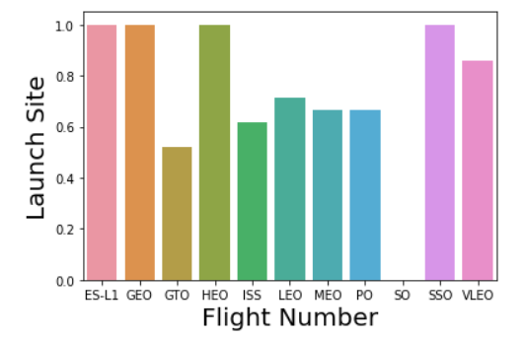
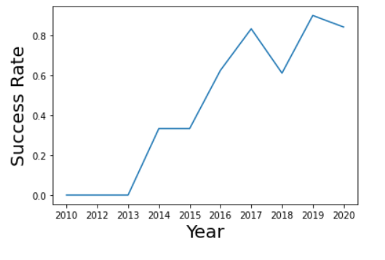
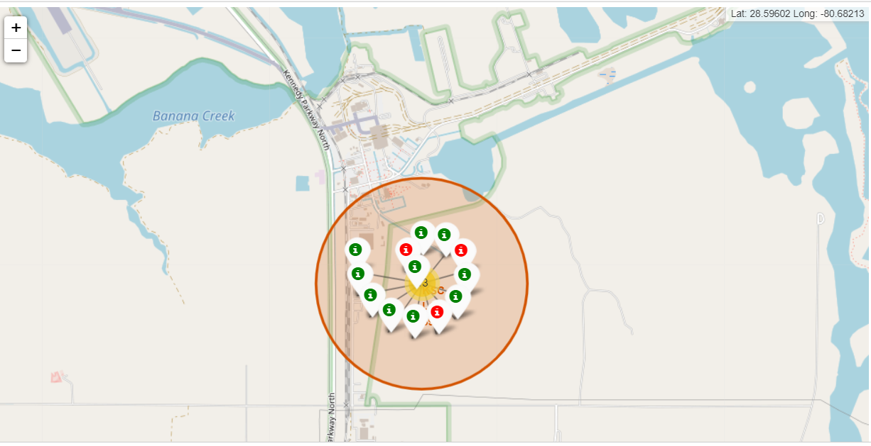
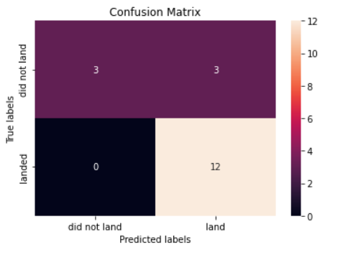
Results

Slide 17


Slide 18
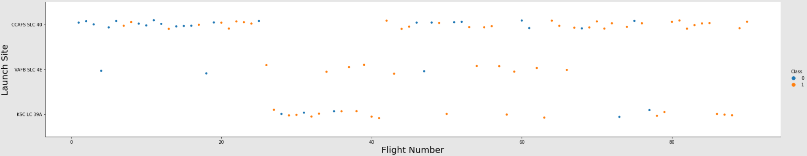
Flight Number vs. Launch Site
Explanation: As the number of flights increases, the first stage is more likely to land successfully. Different launch sites have different success rates.

Slide 19
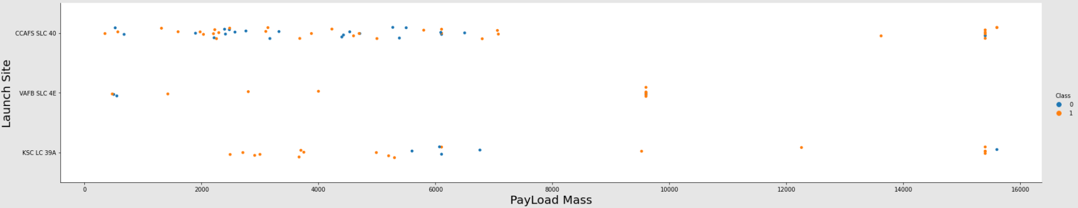
Payload vs. Launch Site
Explanation: As the mass increases, the first stage is less likely to land successfully. Different launch sites have different success rates.

Slide 20
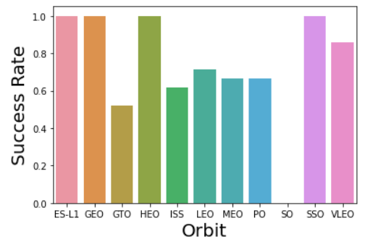
Success Rate vs. Orbit Type
Explanations: Different orbits has different success rate. ES-L1, GEO, HEO, and SSO had success rate of 100%. Meanwhile, SO never succeeded.

Slide 21
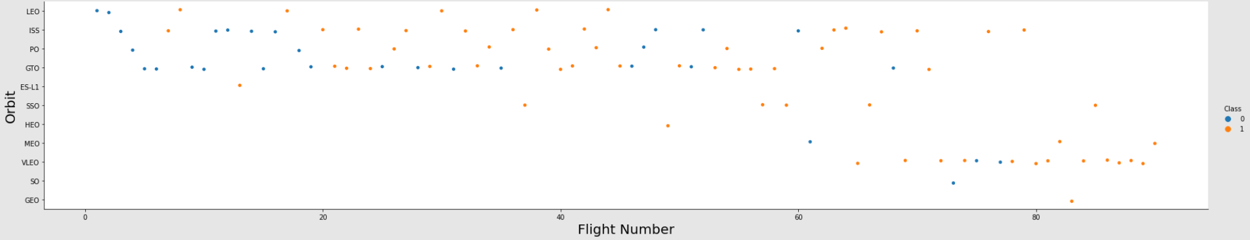
Flight Number vs. Orbit Type
Explanation: As the number of flights increases, the first stage is more likely to land successfully. Different orbits have different success rates.

Slide 22
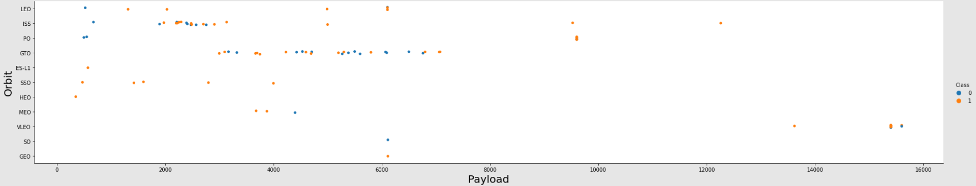
Payload vs. Orbit Type
Explanations: As the mass increases, the first stage is more likely to failed. ES-LI, SSO, HEO are most successful orbit with small payload.

Slide 23
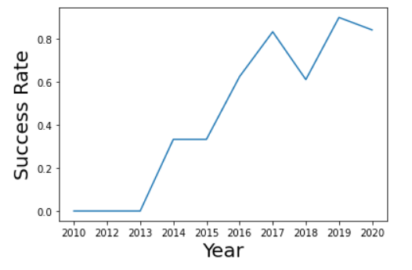
Launch Success Yearly Trend
Explanations: From 2013, the success rate increases until 2020, despite some minor fluctuations.

Slide 24
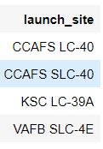
All Launch Site Names
Unique launch sites: CCAFS LC-40, CCAFS SLC-40, KSC LC-39A, VAFB SLC-4E
Short explanation: selection unique launch sites from the table

Slide 25
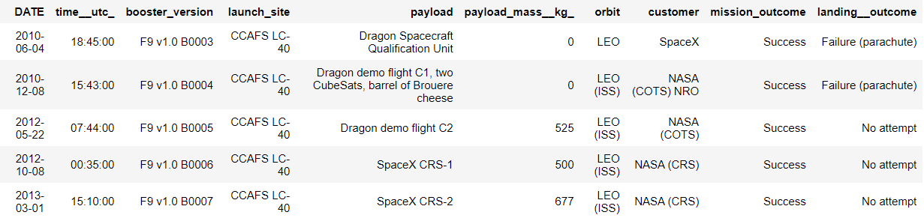
Launch Site Names Begin with 'CCA'
Short explanation: get rows from the table which the first 3 characters equals CCA

Slide 26
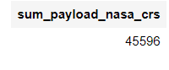
Total Payload Mass
Short explanation: get sum from ‘payload_mass__kg_’ column where customer equals 'NASA (CRS)'

Slide 27
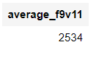
Average Payload Mass by F9 v1.1
Short explanation: get average from ‘payload_mass__kg_’ column where ‘booster_version’ starts by 'F9 v1.1’ string

Slide 28
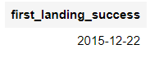
First Successful Ground Landing Date
Short explanation: get min of date from ‘payload_mass__kg_’ column where ‘landing__outcome’ contains 'Success’ string

Slide 29
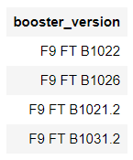
Successful Drone Ship Landing with Payload between 4000 and 6000
Short explanation: get booster_version from ‘payload_mass__kg_’ column where ‘payload_mass__kg_’ > 4000 and ‘payload_mass__kg_’ < 6000 and ‘landing__outcome’ like 'Success (drone ship)'

Slide 30
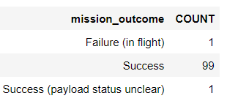
Total Number of Successful and Failure Mission Outcomes
Short explanation: select ‘mission_outcome’, count of duplicated outcome from table.

Slide 31
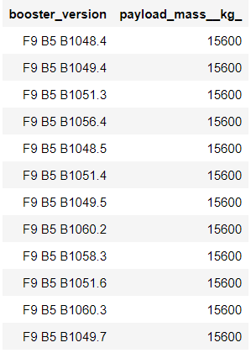
Boosters Carried Maximum Payload
Short explanation: select ‘booster_version’ and ‘payload_mass__kg_’ where its mass equals max of payload_mass

Slide 32
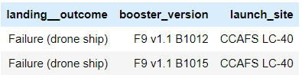
2015 Launch Records
Short explanation: select ‘landing__outcome’, ’booster_version’ and ‘launch_site’ from table where ‘landing_outcome’ contains ‘failure’ string and year of date is 2015

Slide 33
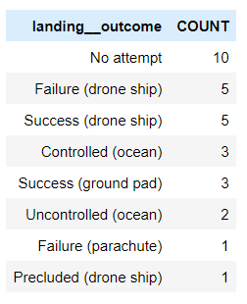
Rank Landing Outcomes Between 2010-06-04 and 2017-03-20
Short explanation: select ‘landing__outcome’ and count its duplicated values, where the date is between 2010-06-04 and 2017-03-20, and ranked from the most counted outcome.

Slide 34


Slide 35
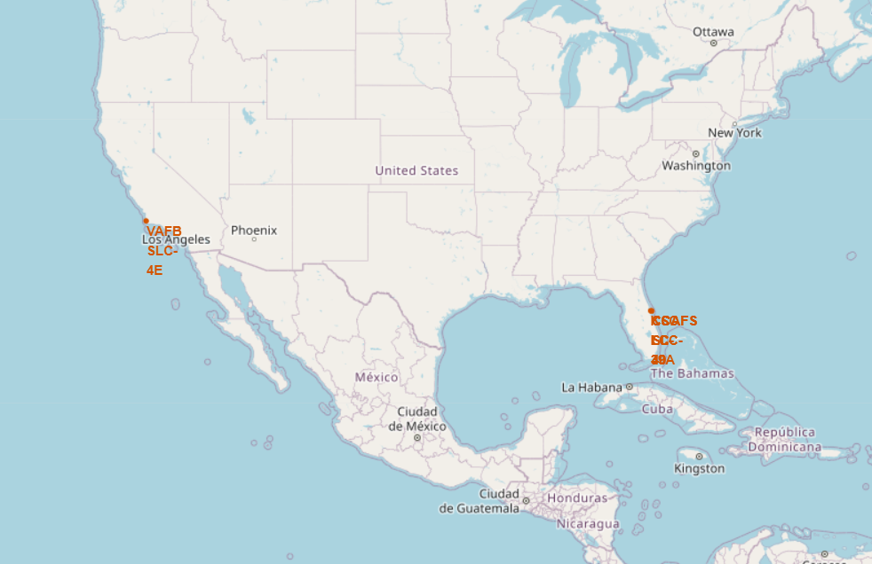
Mark all launch sites on a map
All launch sites concentrated at two places only

Slide 36
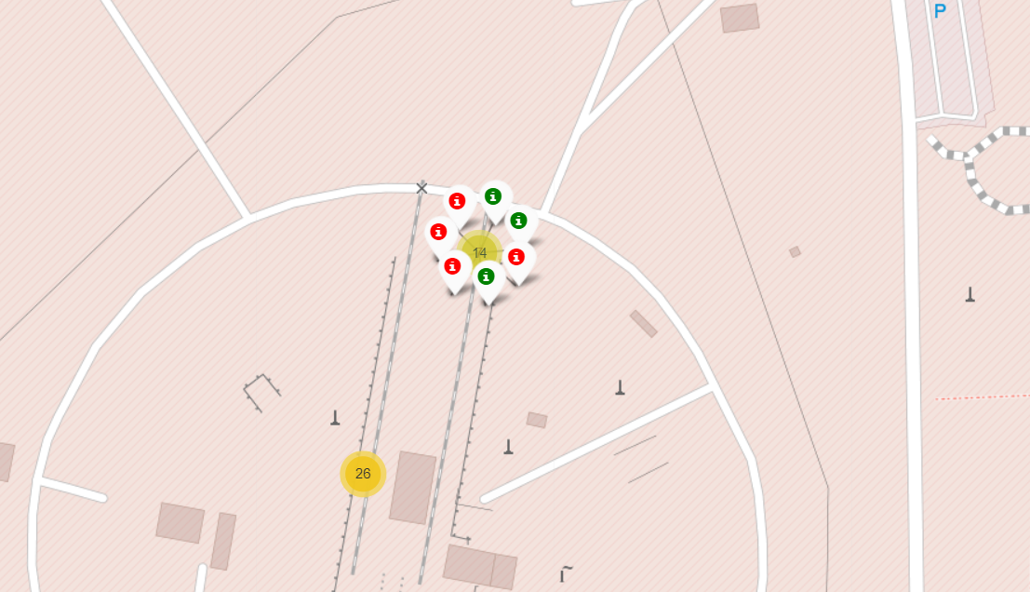
Mark the success/failed launches for each site on the map
Green icons represent success launches, while red one represent failed records.
In the screenshot, this place has 7 launches, and three of them are success.

Slide 37
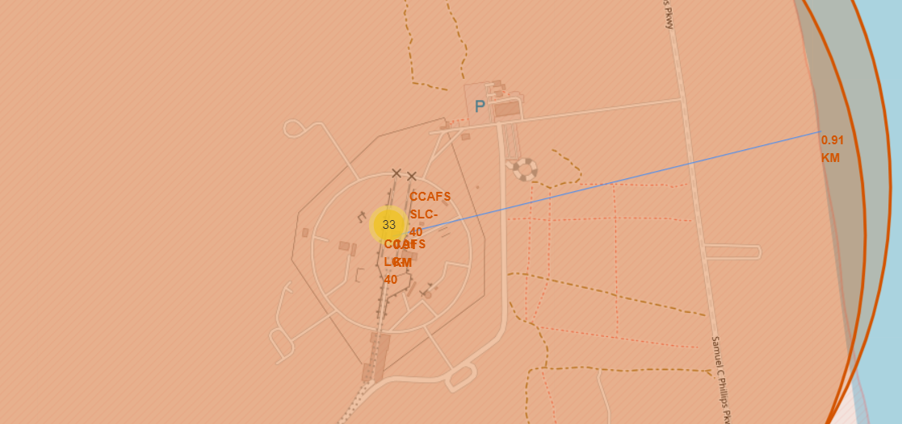
Calculate the distances between a launch site to its proximities
The distance from CCAFS LC-40 launch site to nearest coastline is approximately 0.91km

Slide 38


Slide 39
<Dashboard Screenshot 1>
Replace <Dashboard screenshot 1> title with an appropriate title
Show the screenshot of launch success count for all sites, in a piechart
Explain the important elements and findings on the screenshot

Slide 40
<Dashboard Screenshot 2>
Replace <Dashboard screenshot 2> title with an appropriate title
Show the screenshot of the piechart for the launch site with highest launch success ratio
Explain the important elements and findings on the screenshot

Slide 41
<Dashboard Screenshot 3>
Replace <Dashboard screenshot 3> title with an appropriate title
Show screenshots of Payload vs. Launch Outcome scatter plot for all sites, with different payload selected in the range slider
Explain the important elements and findings on the screenshot, such as which payload range or booster version have the largest success rate, etc.

Slide 42


Slide 43
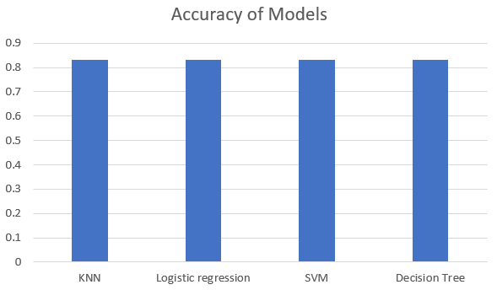
Classification Accuracy
Practically all these algorithms give the same result

Slide 44
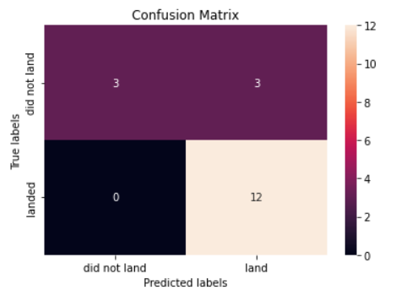
Confusion Matrix
Using confusion matrix, we can see that the model can distinguish between different classes with high accuracy. The only problem is with false positives (predicted landed but in fact didn’t)

Slide 45
Conclusions
After the project, we can make a model with 83,33% chance that it will predict True. We can utilize the model, in relation with present data, to make a prediction that the first landing will be successful or failed.
Furthermore, SpaceX can use the model to change their process system (place that take off, payload,…) in order to maximize the positive result.

Slide 46
Appendix
IBM Data Scientist: Joseph Santarcangelo and his team
Coursera Discussion Forum
Stackoverflow
Python, Pandas, Folium,.. Documentary on Google.

Slide 47


